Slide 1
Causal diagrams (DAGs)
Advanced Epidemiology
22 January 2019
Regina Prigge: s1570624@sms.ed.ac.uk
Colin Fischbacher: colin.fischbacher@nhs.net

Slide 2
Why do we need causal diagrams?
Interest: The relationship between depression and subsequent cardiovascular diseases
Literature
1. To define hypotheses
2. To identify other variables that have a relationship with depression as well as with CVD:
Physical activity, alcohol intake, menopausal status, age, sex, ethnicity, diet, weight gain, different medications, biological dysregulations, and many more...
Need to communicate to others what my theory is
Can be difficult to explain in words
Causal diagram as a way of making clear what our theories and assumptions are

Slide 3
Usefulness of causal diagrams
Identifies variables relevant to research
Summarize knowledge
Visualize assumptions
Graphic representation of causal network
Enhance communication among researchers

Slide 4
Directed acyclic graphs (DAGs)
Directed: Edges (arrowheads) imply a direction
Acyclic: A variable cannot cause itself
A
(treatment)
Y
(outcome)
A
Y

Slide 5
Visualization of DAGs
Presence of arrow:
We assume direct causal effect
We are not willing to assume that causal effect does not exist
Absence of arrow = strong assumption:
We are willing to assume that causal effect does not exist
Direction of arrow:
Assumed direction of effect
Time flows from left to right
We do not distinguish between harmful and protective effects
A
causes
Y
earlier in life
later in life

Slide 6
What does this DAG tell us?
sex
weight gain
age
depression
physical inactivity
cardiovascular
disease
socioeconomic
status
smoking
genetic variant
antidepressant use?

Slide 7
Ideal RCTs
What do I mean by “ideal” RCT?
Treatment groups are exchangeable
No loss to follow-up
Double-blinding
Perfect adherence to treatment strategies
Unconditional exchangeability
A
Y
exposure,
eg a drug
outcome,
eg heart attack

Slide 8
Non-ideal RCTs and observational studies
Conditional exchangeability (more than two variables)
What type of other variables could there be?
Common sources
Common effects
Mediators

Slide 9
Common sources – non-collider
H0: There is no causal relationship between exposure A and outcome Y, given variable L
Association flows between variables regardless of the direction of the causal arrows (association from A→L→Y)
“back-door path” is open
L
A
?
Y
common source
(non-collider)
exposure
outcome

Slide 10
Common sources – non-collider
H0: There is no causal relationship between exposure A and outcome Y, given variable L
“Back-door path” is open
We can only estimate causal effects if there is no open back-door path
L
A
?
Y
common source,
eg smoking
exposure,
eg yellow fingers
outcome,
eg lung cancer

Slide 11
Common sources – non-collider
H0: There is no causal relationship between exposure A and outcome Y, given variable L
“Back-door path” is open
We can interpret our estimates causally if there is no open backdoor-path
L
A
Y
common source,
eg child SES
exposure,
eg adult SES
outcome,
eg adult health

Slide 12
Open and blocked paths – non-collider
Open path
Blocked path
No conditioning on non-collider (common source)
Conditioning on non-collider (common source)
L
A
Y
L
A
Y
smoking
yellow
fingers
lung
cancer
smoking
yellow
fingers
lung
cancer

Slide 13
Conditioning
Adjustment
Stratification
Restriction
“In our statistical analysis we adjusted our results for smoking”
Effect estimates:
Unadjusted (crude):
OR 1.22 (1.14-1.56)
Adjusted for smoking:
OR 1.15 (1.05-1.25)
“We report our results separately for smoker and non-smoker”
Effect estimates:
Smoker:
OR: 1.48 (1.36-1.57)
Non-smoker:
OR: 1.21 (1.15-1.34)
“We only selected participants that were smokers”
Effect estimates:
Smoker:
OR: 1.48 (1.36-1.57)

Slide 14
Confounding
Smoking
Confounding diagram in Intro to Epi:
This is what our diagram looked like when we did not condition on the common source (non-collider):
We did not close an open “back-door path“
L
A
?
Y
Yellow fingers
Lung cancer
L
A
?
Y
Smoking
Yellow fingers
Lung cancer

Slide 15
Common effect - collider
H0: There is no causal relationship between exposure A and outcome Y, given variable L
A
?
Y
L
exposure
outcome
common effect
(collider)

Slide 16
Common effect - collider
H0: There is no causal relationship between exposure A and outcome Y, given variable L
Association does not flow between variables when two arrowheads point towards a variable (no association from A→L←Y)
“Back-door path” is blocked
We can interpret our estimates causally if there is no open backdoor-path
A
Y
L
exposure,
eg genetic variant
outcome,
eg smoking
common effect,
eg heart disease

Slide 17
Common effect - collider
If we restrict our sample to participants with heart disease…
Association does flow between variables when two arrowheads point towards a variable, and this variable was conditioned on (association from A→L ←Y)
“back-door path” is open
A
Y
L
exposure,
eg genetic variant
outcome,
eg smoking
common effect,
eg heart disease

Slide 18
Common effect - collider
H0: There is no causal relationship between exposure A and outcome Y, given variable L
Association does not flow between variables when two arrowheads point towards a variable (no association from A→L←Y)
“back-door path” is closed
A
Y
L
exposure,
eg diabetes
outcome,
eg knee injury
common effect,
eg hospitalization

Slide 19
Common effect - collider
H0: There is no causal relationship between exposure A and outcome Y, given variable L
“Back-door path” is open
Estimates cannot be interpreted causally
A
Y
L
exposure,
eg diabetes
outcome,
eg knee injury
common effect,
eg hospitalization

Slide 20
Common effect - collider
We might unwillingly condition on a collider because we lose information of those lost to follow-up
Association does flow between variables when two arrowheads point towards a variable, and this variable was conditioned on (association from A→L ←Y)
“back-door path” is open
A
Y
L
exposure,
eg schizophrenia
outcome,
eg cancer
common effect,
eg loss to follow-up

Slide 21
Conditioning on descendent of a collider
Association flows between variables when it was conditioned on the descendent of a collider
“back-door path” is open
Think of descendent of collider as common effect of A and Y through L
A
Y
L
C
exposure,
eg genetic variant
outcome,
eg smoking
common effect,
eg heart disease
descendant
of collider,
eg diuretic medication

Slide 22
Open and blocked paths – collider
Open path
Blocked path
Conditioning on collider (common effect)
Conditioning on effect of collider (common effect)
No conditioning on collider AND no conditioning on effect of collider
A
Y
L
A
Y
L
C
A
Y
L
C

Slide 23
Selection bias
Conditioning on common effect (collider) or conditioning on descendent of collider
We opened a closed “back-door path”
A
Y
L
exposure,
eg genetic variant
outcome,
eg smoking
common effect,
eg heart disease
A
Y
L
C
exposure,
eg genetic variant
outcome,
eg smoking
common effect,
eg heart disease
descendant
of collider,
eg diuretic medication

Slide 24
Confounding vs selection bias
Confounding:
Not conditioning on common source (non-collider) → we did not close an open “back-door path“
Selection bias:
Conditioning on common effect (collider) or conditioning on effect of collider → we opened a closed “back-door path”
L
A
Y
A
Y
L
A
Y
L
C

Slide 25
Mediation
Factor is on the causal pathway
What do we want to do here?
A
Y
B
exposure,
eg gene
mediator,
eg abnormal huntingtin (protein)
outcome,
eg huntington‘s
disease
A
B
Y
exposure,
eg depression
mediator,
eg weight gain
outcome,
eg CVD

Slide 26
Mediation – Estimation of total effect
A
Y
complete
mediation
B
gene
abnormal
huntingtin
(protein)
Huntington’s
disease
A
B
Y
incomplete
mediation
depression
weight gain
CVD

Slide 27
Mediation – Estimation of indirect and direct effect
A
Y
complete
mediation
B
gene
abnormal
huntingtin
(protein)
Huntington’s
disease
A
B
Y
incomplete
mediation
depression
weight gain
CVD

Slide 28
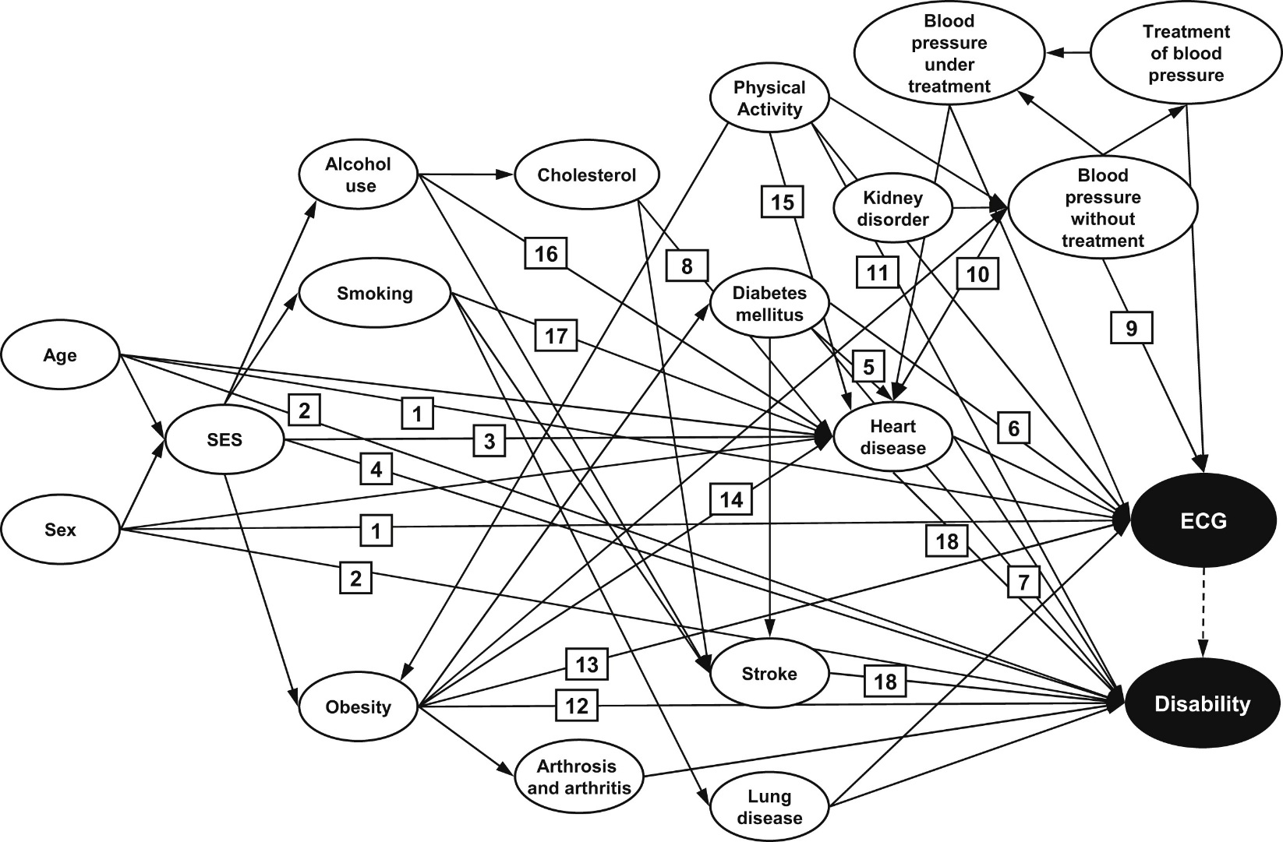
The world is more complicated than that...
(Röhrig et al, 2014)

Slide 29
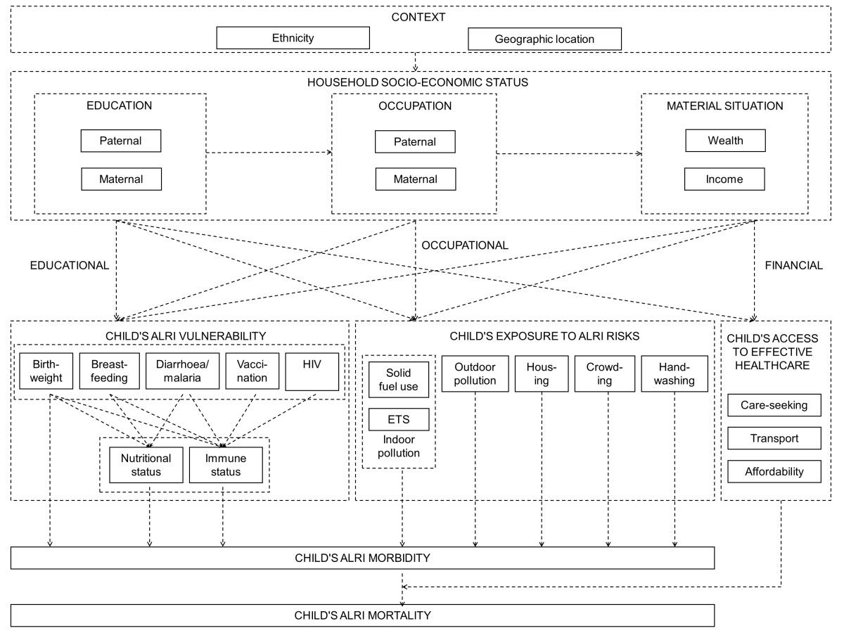
A conceptual causal diagram
(Rehfuess et al, 2013)

Slide 30
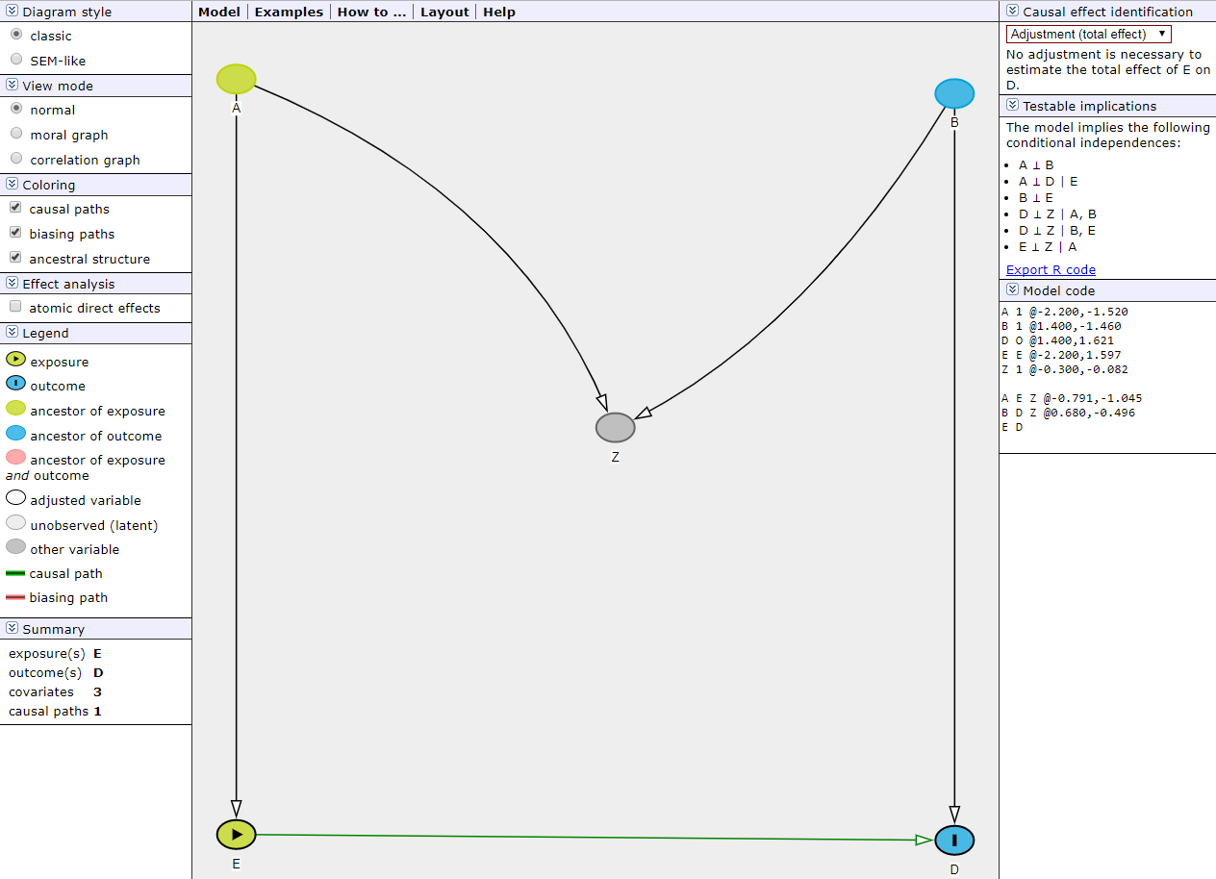
DAGitty
Free software for drawing causal diagrams
Helps you identify the variable you have to condition on in order to interpret your estimate causally
http://www.dagitty.net/dags.html#

Slide 31
References
Greenland, S., Pearl, J. and Robins, J.M., 1999. Causal diagrams for epidemiologic research. Epidemiology, pp.37-48.
Hernán, M.A., Hernández-Díaz, S. and Robins, J.M., 2004. A structural approach to selection bias. Epidemiology, 15(5), pp.615-625.
Hernán, M.A. and Robins, J.M., (forthcoming). Graphical representation of causal effects. In: Causal inference. Boca Raton, FL: CRC, p.69-82.
Hernán, M.A. and Robins, J.M., (forthcoming). Confounding. In: Causal inference. Boca Raton, FL: CRC, p.83-94.
Hernán, M.A. and Robins, J.M., (forthcoming). Selection bias. In: Causal inference. Boca Raton, FL: CRC, p.95-108.
Textor, J., Hardt, J. and Knüppel, S., 2011. DAGitty: a graphical tool for analyzing causal diagrams. Epidemiology, 22(5), p.745.
Rehfuess, E., Best, N., Briggs, D. and Joffe, M. (2013). Diagram-based Analysis of Causal Systems (DACS): elucidating inter-relationships between determinants of acute lower respiratory infections among children in sub-Saharan Africa. Emerging Themes in Epidemiology, 10(1), p.13.
Röhrig, N., Strobl, R., Müller, M., Perz, S., Kääb, S., Martens, E., Peters, A., Linkohr, B. and Grill, E. (2014). Directed acyclic graphs helped to identify confounding in the association of disability and electrocardiographic findings: results from the KORA-Age study. Journal of Clinical Epidemiology, 67(2), pp.199-206.

Slide 32
Recap - Unconditional exchangeability
Achieved through randomization
Groups are equal in all aspects other than their exposure status
Treatment effect would have been the same among the untreated if they had been treated
Outcome
Treated
No outcome
Study group
Outcome
Untreated
No outcome
Notes:
This is a graph of a randomized experiment. Study groups is divided into treatment and control group and we then observe whether an outcome occurs. We assume that the treated and untreated are exchangeable.

Slide 33
Recap - Conditional exchangeability
Groups are different in aspects other than their exposure status
Within each strata of symptom status, treatment effect would have been the same among the untreated if they had been treated
Outcome
Treated
Showed
symptom
No outcome
Outcome
Untreated
No outcome
Study group
Outcome
Treated
Didn’t show
symptom
No outcome
Outcome
Untreated
No outcome
Notes:
In contrast, this graph shows an additional variable (symptom status). This might be the graph of a conditional experiment in which the proportion of people allocated to treatment differed depending on whether a person did or did not show symptoms. Here, we can’t say that we think the treated and untreated are exchangeable because symptom status has influenced whether someone was more or less likely to receive treatment. However, we can assume exchangeability of treated and untreated within levels of symptom status → conditional exchangeability!

